Slide 1




HARDHAT
ERC20
Get Started

Slide 2

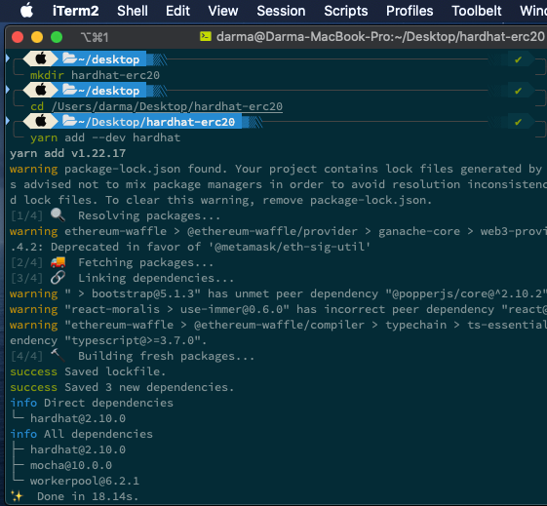
CREATE NEW PROJECT
01.
Create Folder
mkdir hardhat-erc20
02.
Framework hardhat
yarn add --dev hardhat

Slide 3


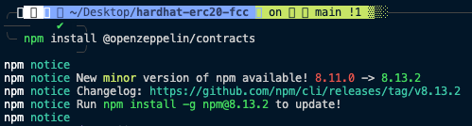
Install Open Zeppelin
Instal dengan cara "npm install @openzeppelin/contract" pada terminal anda
Blockchain

Slide 4

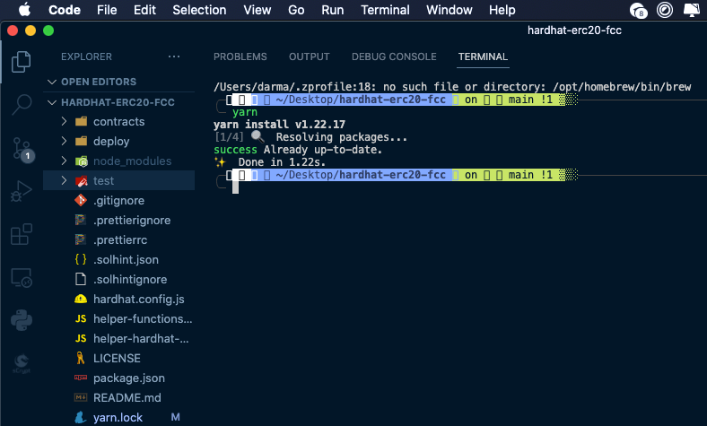


Best Company
We will be at the forefront of technology,
speed and modernism
Install Dependency
Best Methods
We will be at the forefront of technology,
speed and modernism

Slide 5

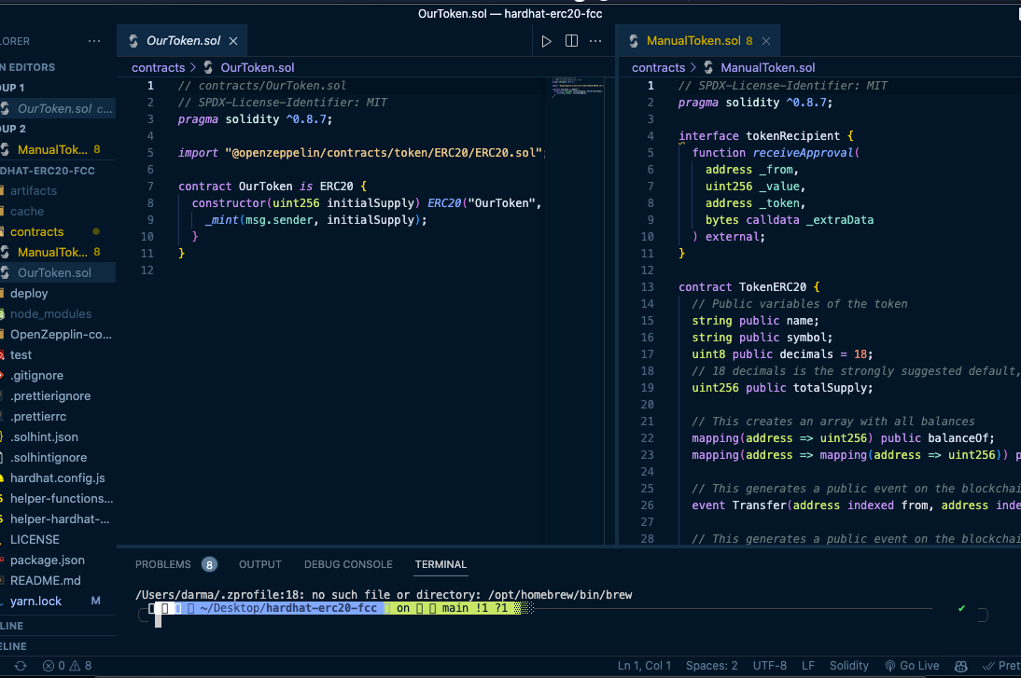

OpenZeppelin-Contract
Create code with openzeppelin
Blockchain

Slide 6
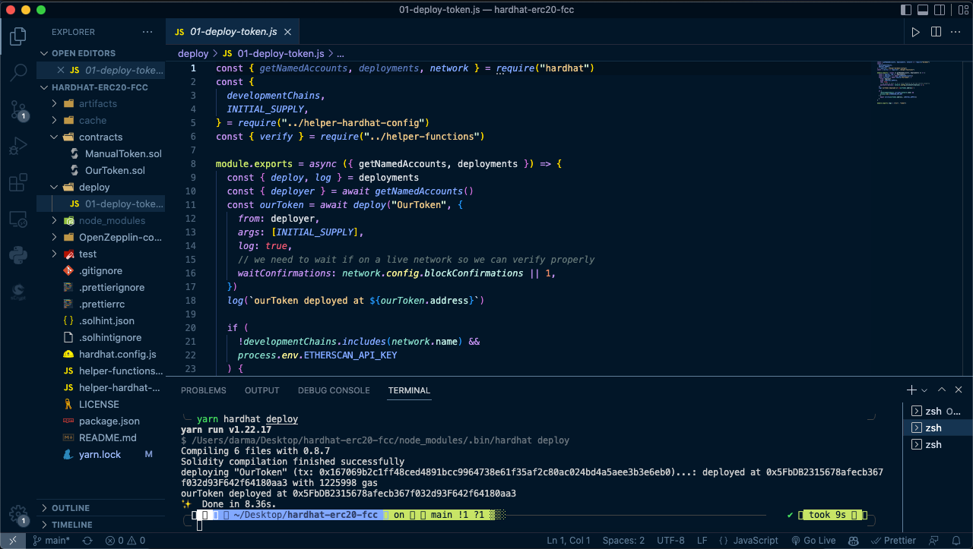
Sourcode
Deploying Token

Slide 7
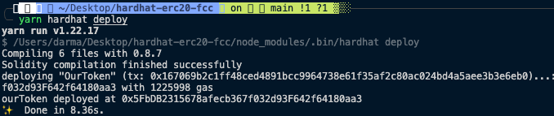
Deploying Token
Blockchain

